Slide 1
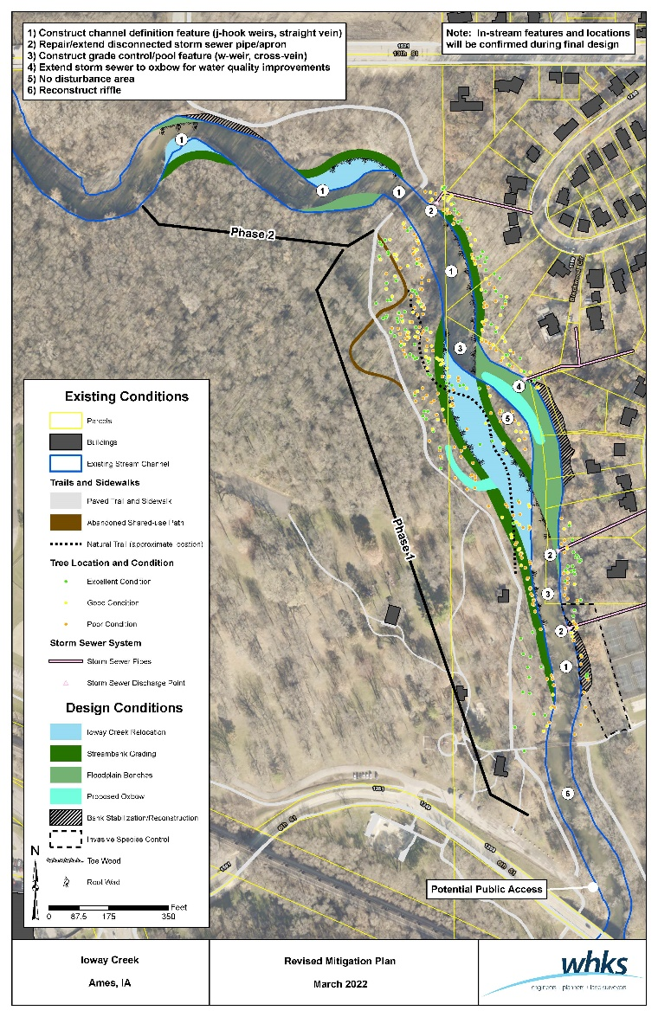
Ioway Creek at Brookside –What’s Next?
April/May – Review comments from March/April meetings
April 19 - City Council- Watersheds Update Workshop
April 21 - Parks and Recreation Commission-Project Update
Summer - Public meeting to present 75% design plans
September - Construction bid letting
Fall 2022/Winter 2023 - Construction
Contact: Liz Calhoun (515)239-5575 Liz.Calhoun@cityofames.org
www.CityofAmes.org\IowayCreekBrookside

