Slide 1
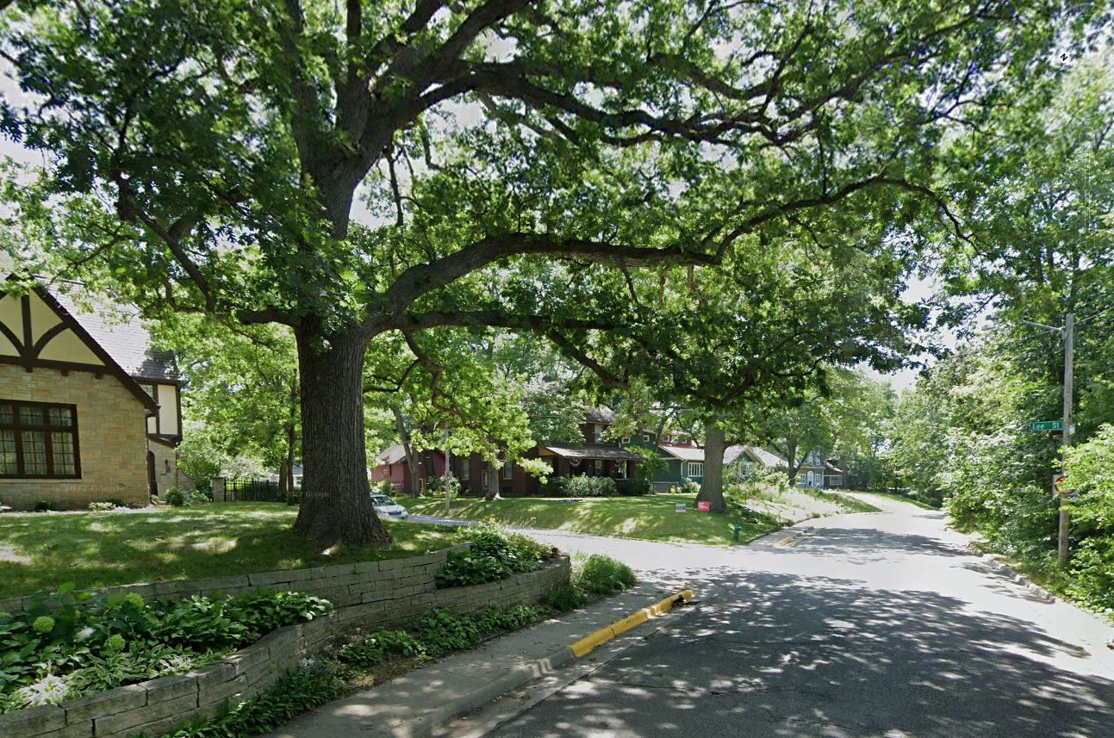

Two-Family Units (Duplexes)
Zoning Text Amendment
January 17, 2024

Slide 2
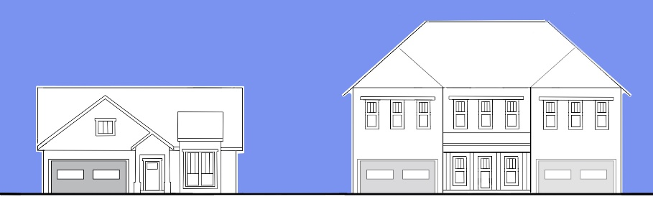
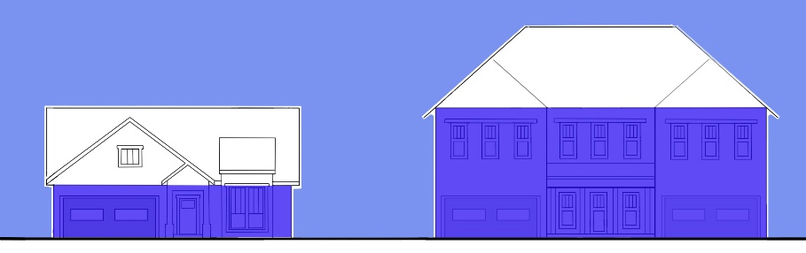
Windows and Transparency – 15%
The principal and recessed facade shall include a minimum solid to void ratio of 15%.
Solid means the area calculated by multiplying the width of the front facing facade by the height measured between the foundation and roof line, not including a gable area.

Slide 3
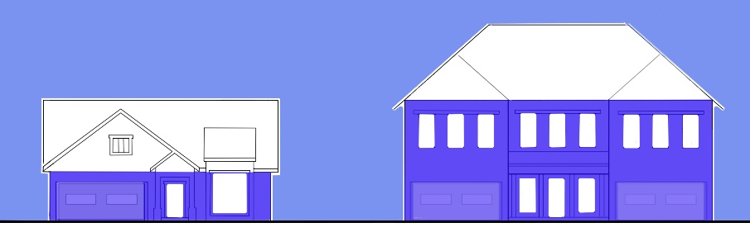
Solid to Void Analysis
Void means the area calculated by adding the area of all window and door openings in the primary facade of a building, measured around the perimeter of the frame. A front facing window or door shall be included in the void area regardless of its location.
[Garages are not included]
Void to Solid Ratio = 25%
Void to Solid Ratio = 18%

Slide 4
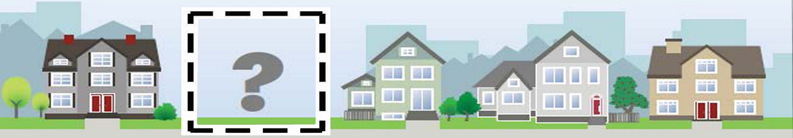
Established Neighborhoods - Pattern Analysis
Evaluate the Block Face – all properties facing one side of a street in a block. May include adjacent properties that are not on the block face, if there are too few examples.

Slide 5
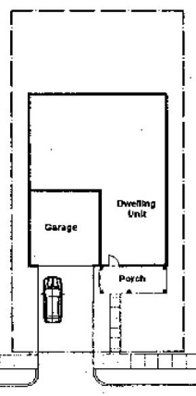
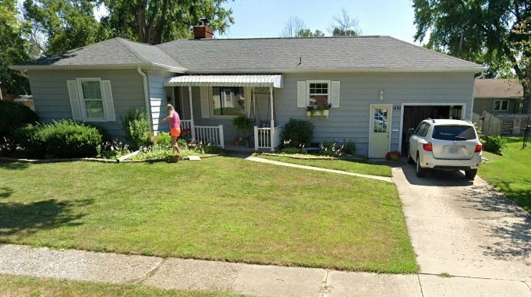
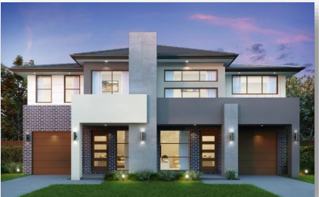
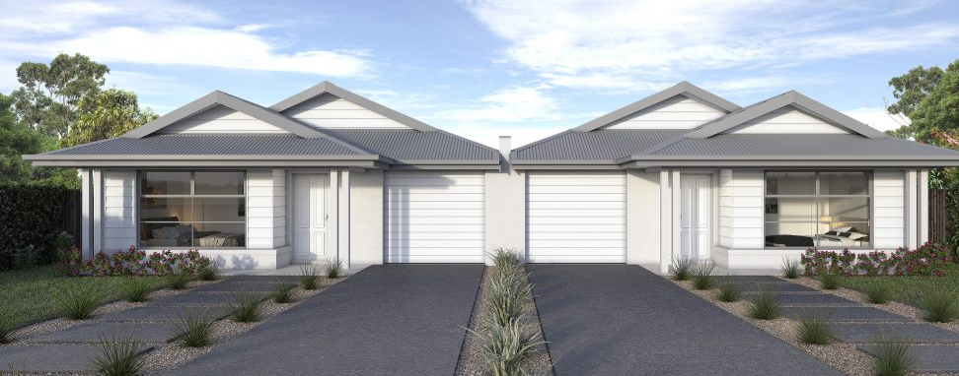
Replicate Garage/Driveway Pattern
Single-Family “Pattern”
Duplex Application of the “Pattern”
Single-Family “Pattern”
Notes:
For NEW Duplexes, replicate existing Garage/Driveway Pattern that occurs as a predominant feature within the block face
Front-Loaded Garage that does not protrude from the street facing façade-

Slide 6
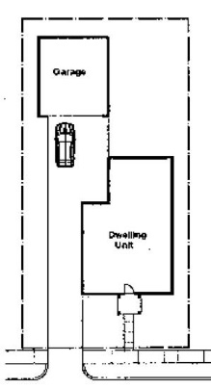
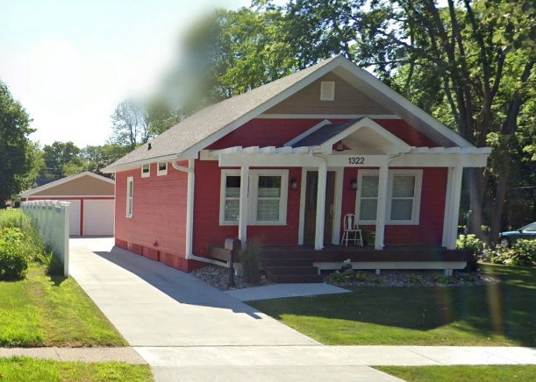
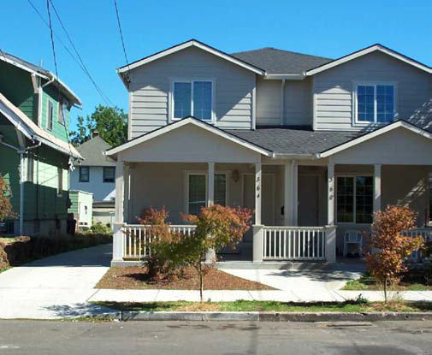
Replicate Garage/Driveway Pattern
Single-Family “Pattern”
Duplex Application of the “Pattern”
Single-Family “Pattern”
Notes:
For NEW Duplexes, replicate existing Garage/Driveway Pattern that occurs as a predominant feature within the block face
Narrow Drive on one side, accessing Detached Garage in the Rear-

Slide 7
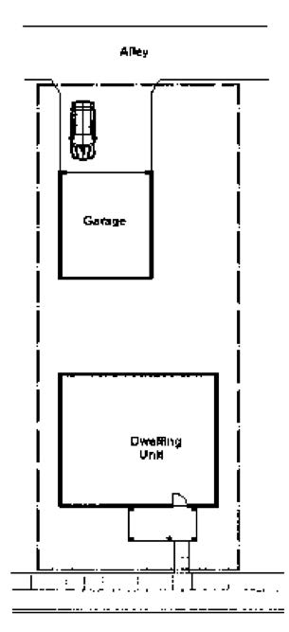
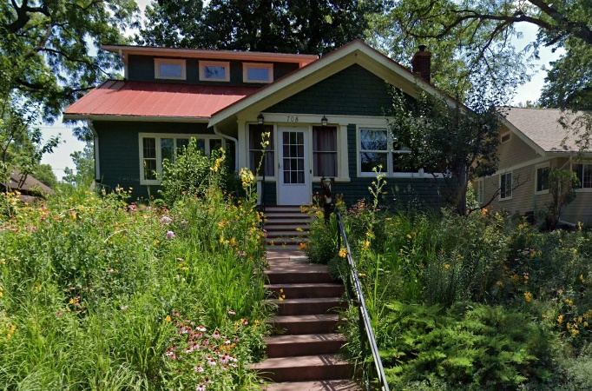
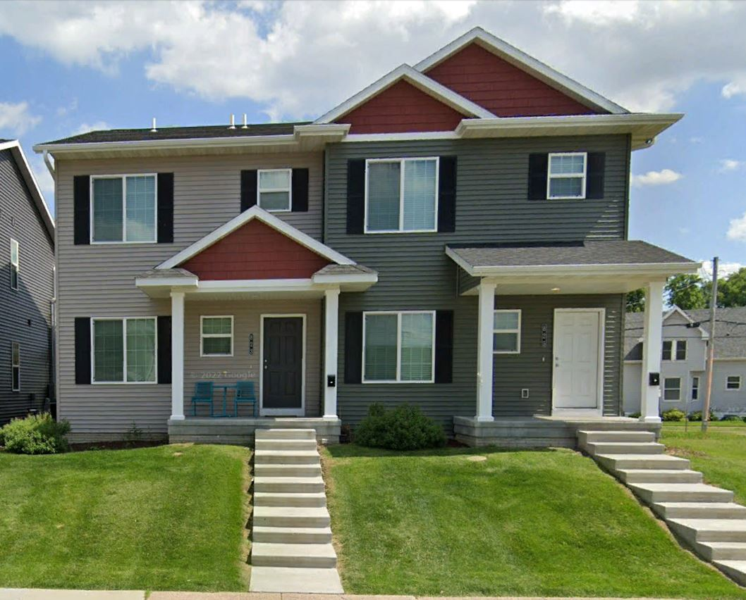
Replicate Garage/Driveway Pattern
Single-Family “Pattern”
Duplex Application of the “Pattern”
Single-Family “Pattern”
Notes:
For NEW Duplexes, replicate existing Garage/Driveway Pattern that occurs as a predominant feature within the block face
Garage in the Rear, accessed from Alley
708 Brookside, Ames IA (single-family)
815 3rd Ave SW, Cedar Rapids IA (two-family)

Slide 8
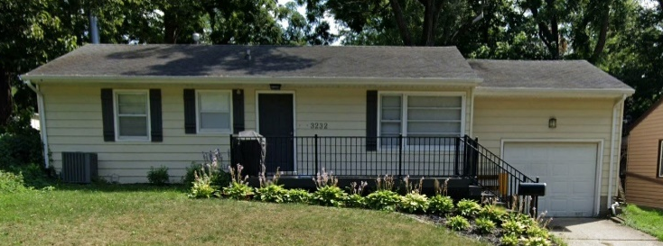
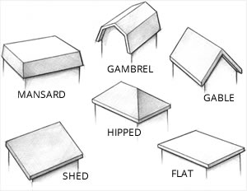
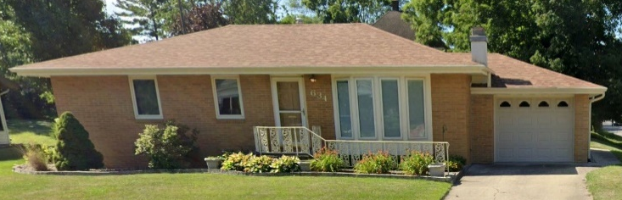
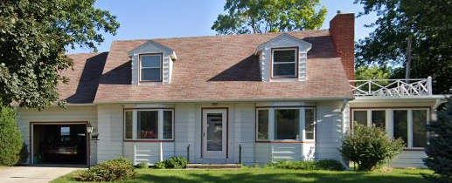
Roof Patterns - Residential (Ames)
Side Gabled
Hipped with Ridge
Dormers

Slide 9
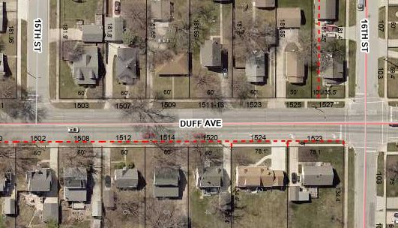
Roof Patterns - Residential (Ames)
Front Gabled
Side Gabled
Dormers

Slide 10
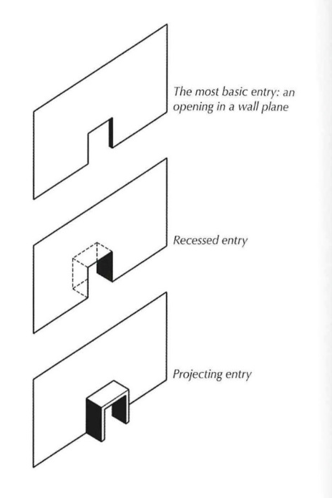
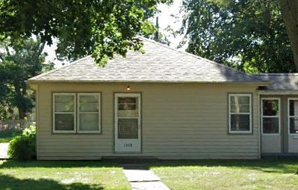
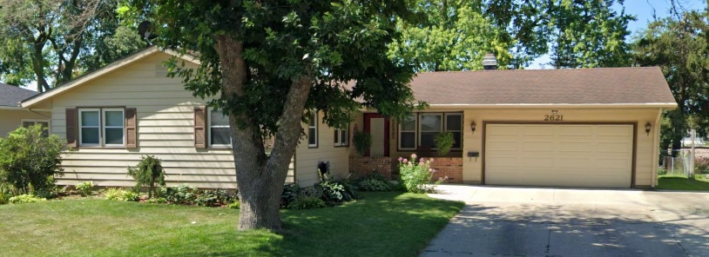
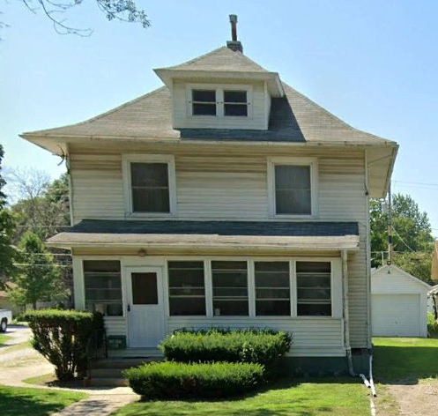
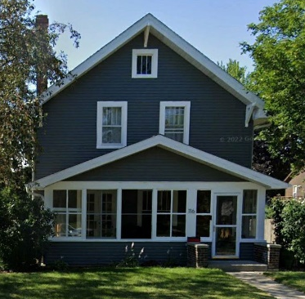
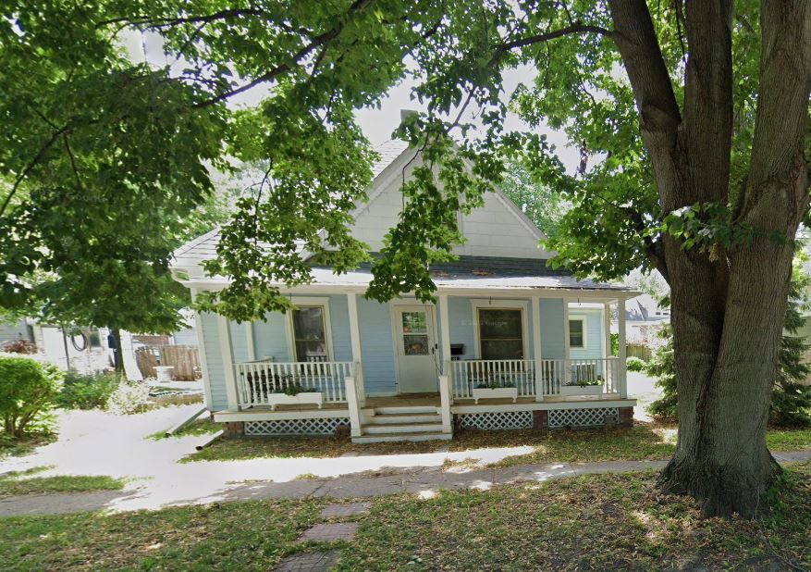
Entry Patterns – Residential (Ames)
Flush
Recessed
Projecting Porch with Flush Entry
Projecting

Slide 11
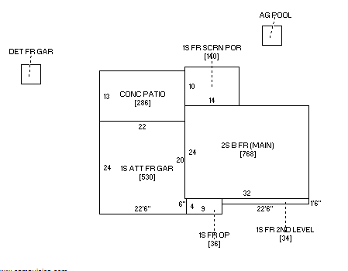
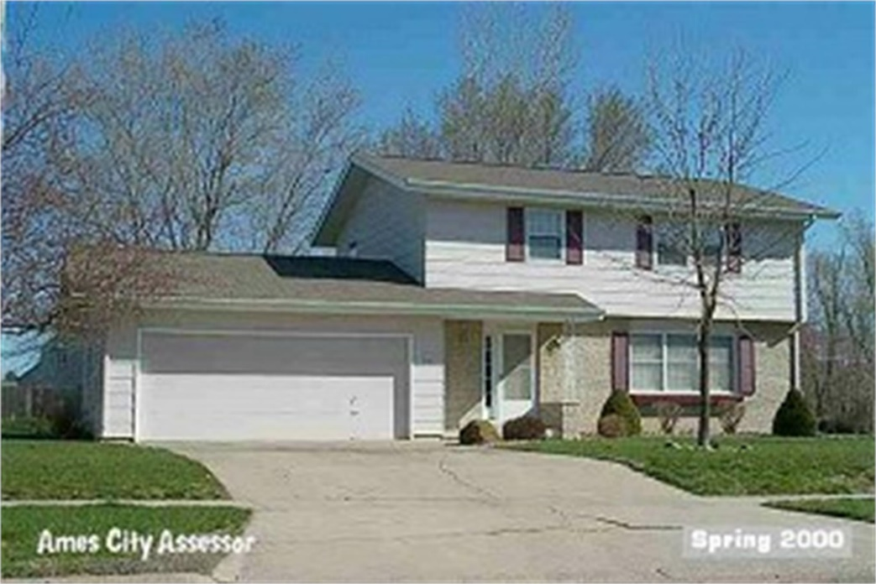
Analysis Resources
Helpful in Determining Recesses and Projections

Slide 12
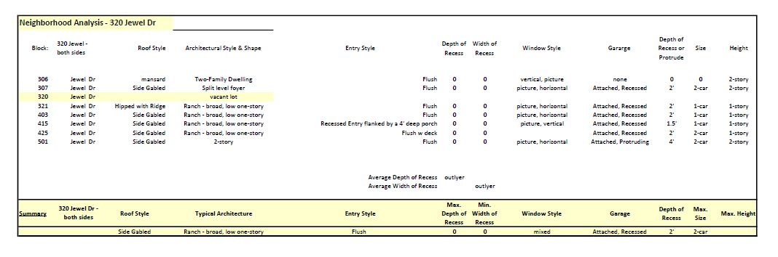
Neighborhood Analysis

Slide 13
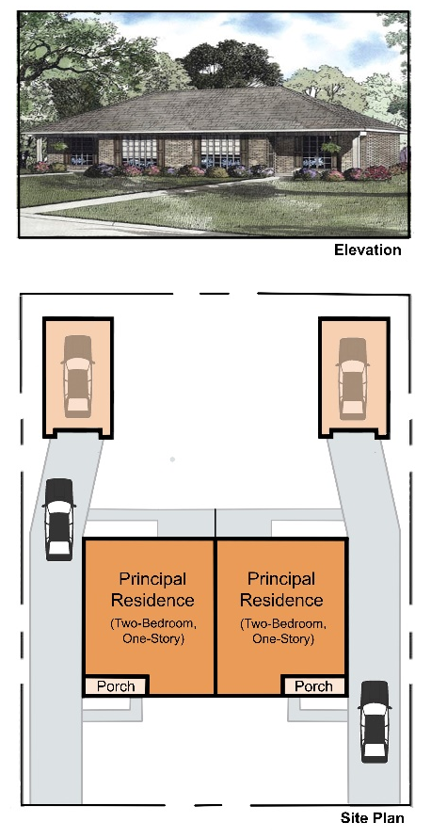
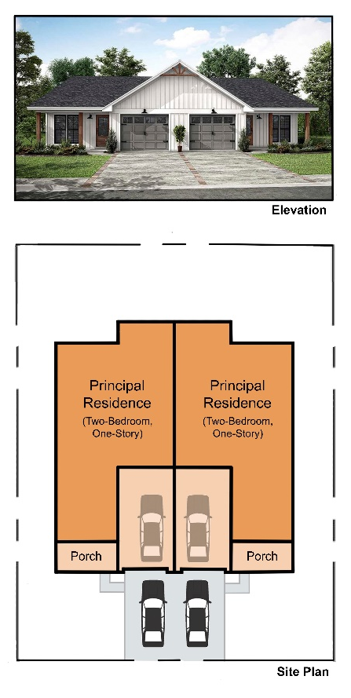
Visual Examples of Compatible Architecture

Slide 14
Other Questions?

